Slide 1

CSE541: Computer Vision
Faculty: Dr Mehul Raval
Group: 7
AU2120225 | Preksha Morbia
AU2140081 | Divya Patel
AU2140082 | Hrishikesh Rana
AU2140099 | Aditya Chaudhari

Slide 2
Problem Statement
Oriented Object Detection (OOD) for AU Drone Dataset
Oriented Object Detection: A Challenging Task
Current Methods Rely on Two-Stage Anchor-Based Detectors
Severe Imbalances Between Positive and Negative Anchor Boxes
Proposal: Center Key Points Detection and Regression of Box Boundary-Aware Vectors (BBAVectors)
Aim: Capture Oriented Bounding Boxes Across the Cartesian Plane
Approach Outperforms Two-Stage Anchor-Based Detectors
Direct Prediction of Box Parameters

Slide 3
Methodology
Pre-trained ResNet101 Conv1-5 is used as the base for feature extraction.
Image is up-sampled to increase the size of extracted features by four times.
Up-sampled feature map is refined with a 3x3 Conv layer.
Refined feature map is concatenated with a shallow layer and refined further with a 1x1 convolutional layer.
Output feature map is divided into four branches:

Slide 4
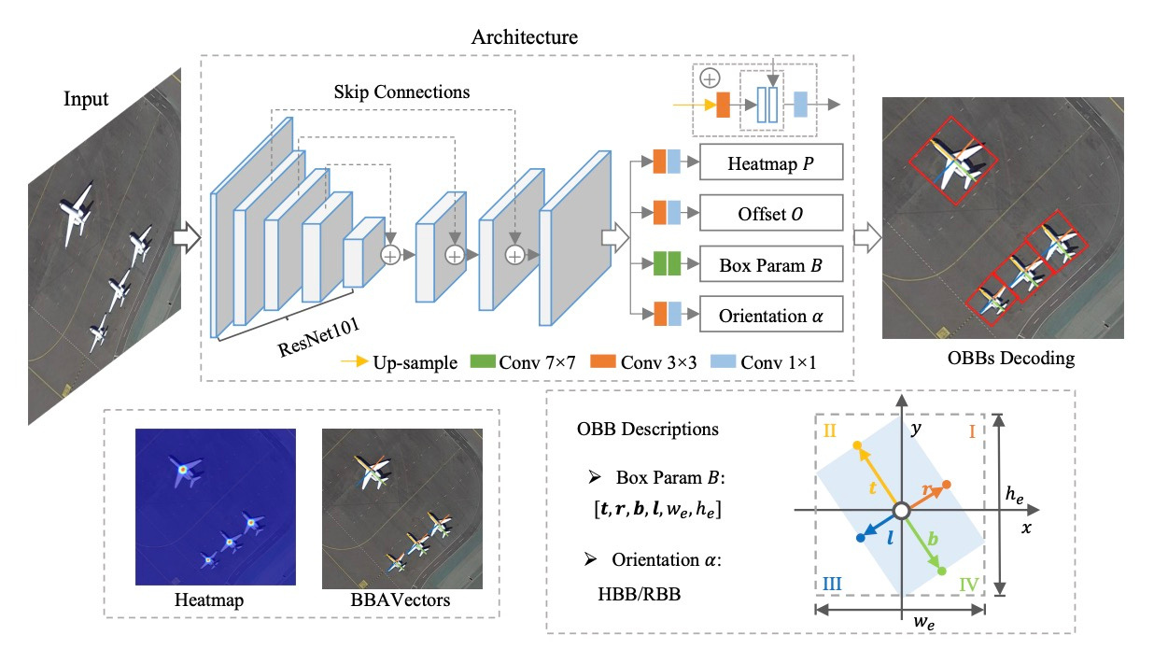
Methodology
*[1] J. Yi, P. Wu, B. Liu, Q. Huang, H. Qu, and D. Metaxas, “Oriented Object Detection in Aerial Images with Box Boundary-Aware Vectors.” Accessed: Mar. 16, 2024.
https://arxiv.org/pdf/2008.07043v2.pdf

Slide 5
Methodology
Heat maps detect oriented objects' centre points, trained with focal loss using 2D Gaussian from the ground truth to reduce noise reduction. Training loss used here was Variant Focal Loss to tackle imbalance..
Offset map predicts offsets to compensate for differences between floating centre points and integer centre points. Training loss used here was Smooth L1 loss.
Box parameters predict parameters for box boundary aware (BBA) vectors distributed in four quadrants of the Cartesian coordinate system. Training loss used here was Smooth L1 Loss.
Orientation categorises objects into horizontal bounding boxes (HBB) and rotated bounding boxes (RBB) to address detection failures in corner cases. Training loss used here was Binary Cross Entropy Loss.

Slide 6
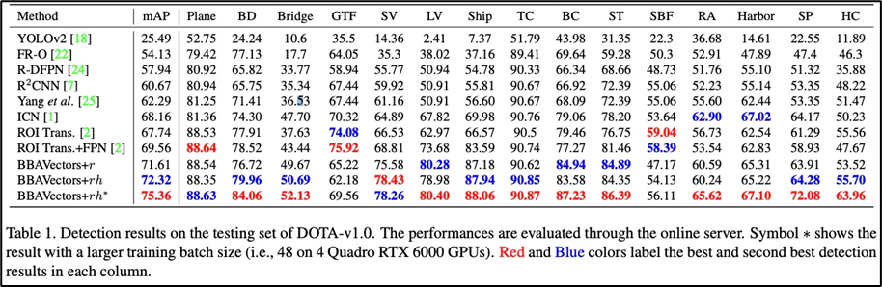

Results
With the orientation classification and additional external Oriented Bounding Box (OBB) size parameters, method achieves 72.32% accuracy. With the larger training batch size, it achieves 75.36% accuracy. Moreover, this method is robust enough to capture objects even in tiny, crowded vehicles.
*[1] J. Yi, P. Wu, B. Liu, Q. Huang, H. Qu, and D. Metaxas, “Oriented Object Detection in Aerial Images with Box Boundary-Aware Vectors.” Accessed: Mar. 16, 2024.
https://arxiv.org/pdf/2008.07043v2.pdf

Slide 7
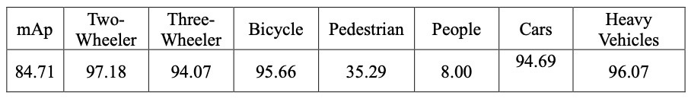
Results
Performance Metrics:
Achieved an mAP50 of 84.71%.
The model operates at a detection speed of 11 frames per second (FPS).
Class Imbalance Handling:
Addressed differing object counts across courses by adding class weights.
Improved precision significantly compared to the original model.
Result Presentation:
Results are detailed in the Table.

Slide 8
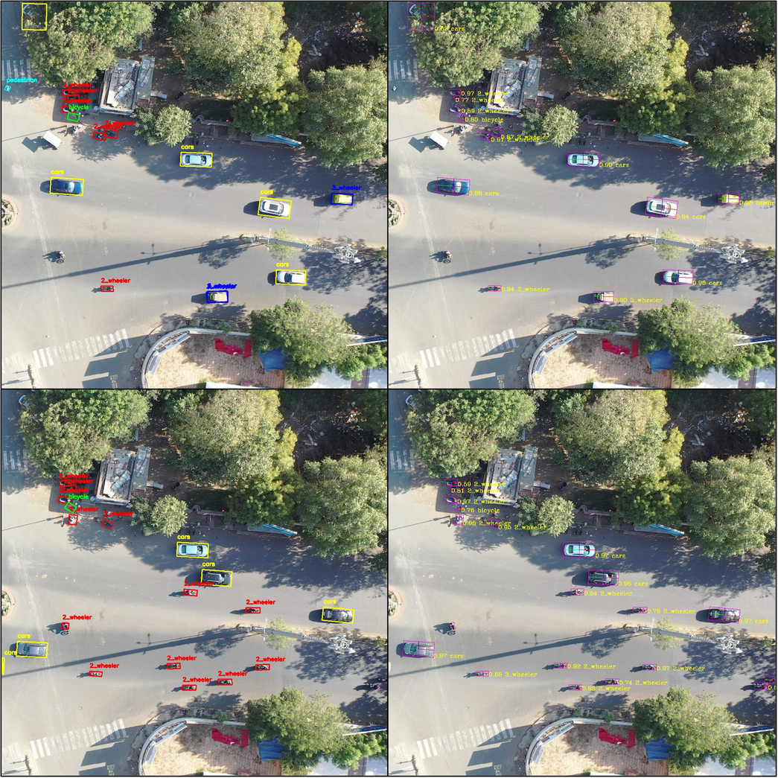
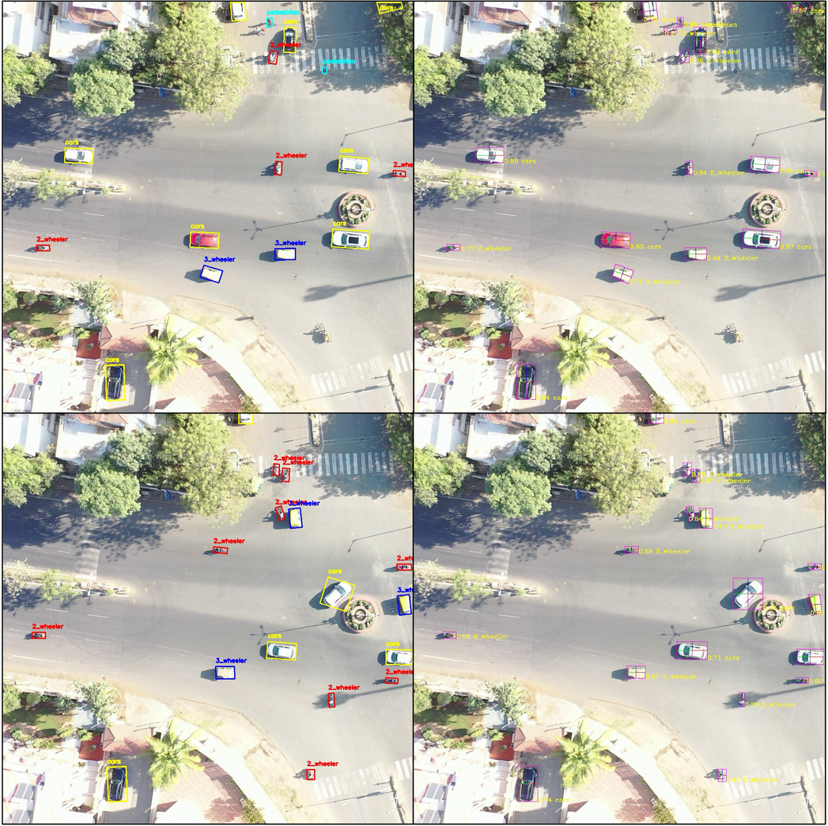
Results
Ground Truth | Resultant Image
Ground Truth | Resultant Image

Slide 9
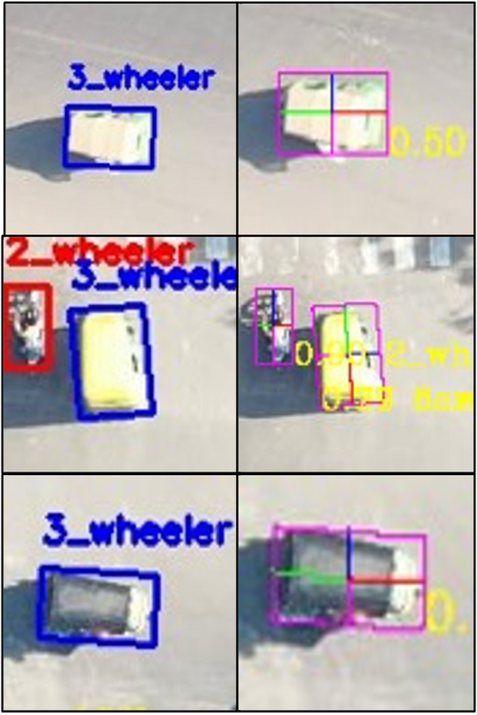
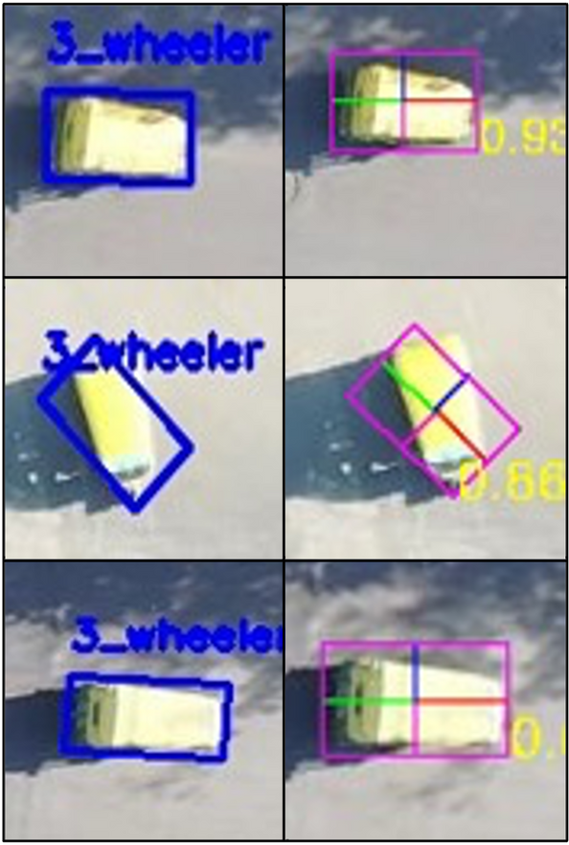
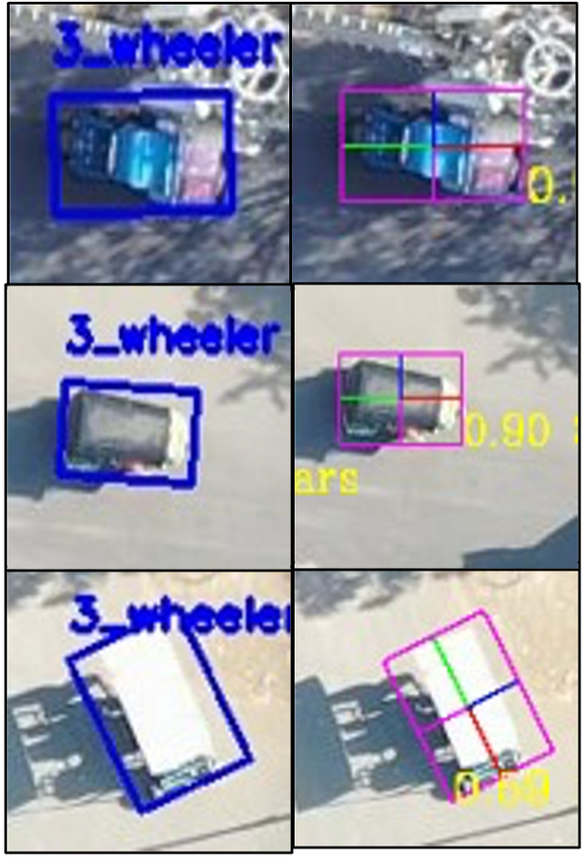
Results
3_wheeler
Ground Truth | Resultant Image
Ground Truth | Resultant Image
Ground Truth | Resultant Image

Slide 10
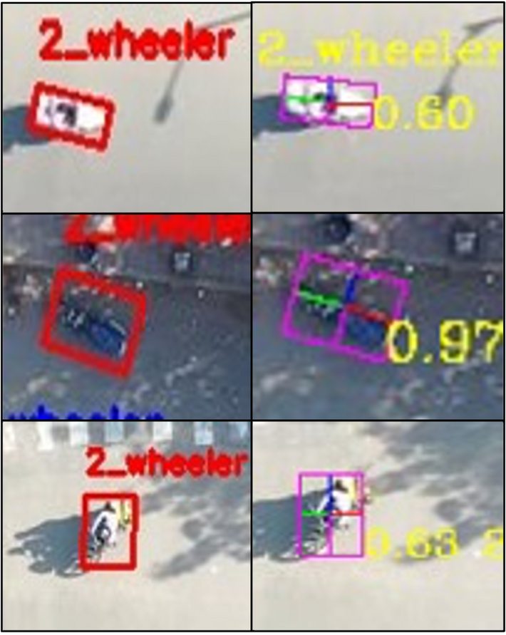
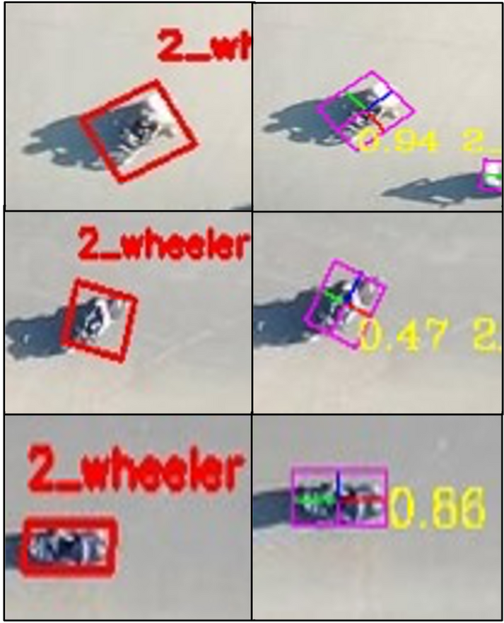
Results
2_wheeler
Ground Truth | Resultant Image
Ground Truth | Resultant Image

Slide 11
Future Work
Image Processing and Detection Expansion
Previously, the project involved processing and detecting around 60,000 objects(approx. 5,000 images). The current step is to run a dataset of approximately 2,20,000 Object(approx. 11,000 images).
This expansion allows for a broader visual data analysis, capturing a more extensive range of scenarios and objects.
Image Processing Speed Enhancement
Previously, data processing occurred at 11 fps (Frames Per Second).
This rate can be improved by using different approaches.

Slide 12
Future Work
Improving Ground Truth Annotation.
After processing a portion of the dataset, it's often observed that some objects' ground truth annotations are incorrectly labelled or incomplete.
To enhance the model's accuracy, a crucial step is identifying and rectifying these inaccuracies in the ground truth data.
This improvement involves carefully reviewing annotations, cross-referencing them with actual object characteristics, and making necessary corrections.

Slide 13
References
[1] J. Yi, P. Wu, B. Liu, Q. Huang, H. Qu, and D. Metaxas, “Oriented Object Detection in Aerial Images with Box Boundary-Aware Vectors.” Accessed: Mar. 16, 2024.
https://arxiv.org/pdf/2008.07043v2.pdf
[2] S. Lang, F. Ventola, and K. Kersting, “DAFNe: A One-Stage Anchor-Free Approach for Oriented Object Detection,” arXiv.org, May 30, 2022. https://arxiv.org/abs/2109.06148v4
[3] Ultralytics, “Home,” Ultralytics
YOLOv8 Docs,
https://docs.ultralytics.com/

Slide 14
THANK YOU

